Slide 1


HOW I GOT AN INFOSEC JOB IN ANOTHER COUNTRY* AND YOU CAN TOO*!
*the US
*there’s a bit of work
Claire N.
HTTPS://WWW.CLAIRESCC.COM/BLOG
This presentation now features 5000% more cat pics

Slide 2

Table of Contents
About
Who’s This Talk For? What is This Talk About?
Why Work in Another Country?
Info About US Work Permits
Which Work Permit Did I Get? How You Can Get One Too
How I Got One
FAQ

Slide 3

Disclaimer
Not a lawyer
Educational/entertainment purposes only
Do your own research!

Slide 4


About Claire N.
She/her
From Toronto, Canada. Currently in Arizona
8 years in IT/infosec
Senior “Detection Engineer” @ $COMPANY
Educational background in Cognitive Science and Infosec
Featured in credits of the game “Ultimate Chicken Horse”
My fingerprints are on file with the cops and the feds
Completed a coney hot dog challenge- ate 6 coneys in under an hour
Sometimes fun at parties

Slide 5

Show of hands…

Slide 6

Who Has Been to the US?
Leave your hands up

Slide 7

Who’s Interested in Getting a Job There?
Wowee you’re definitely listening to the right talk

Slide 8
Who’s This Talk For?

Slide 9
Why Work in Another Country?
Potential higher pool of available jobs
Learn about another culture, their food, history
Get paid more (or less?)
Travel without having to go through customs every time
It’s fun

Slide 10
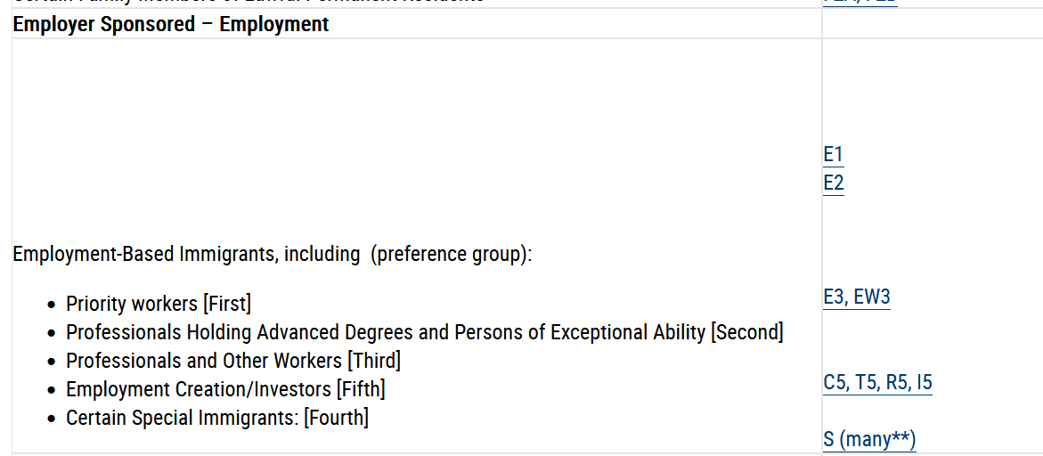
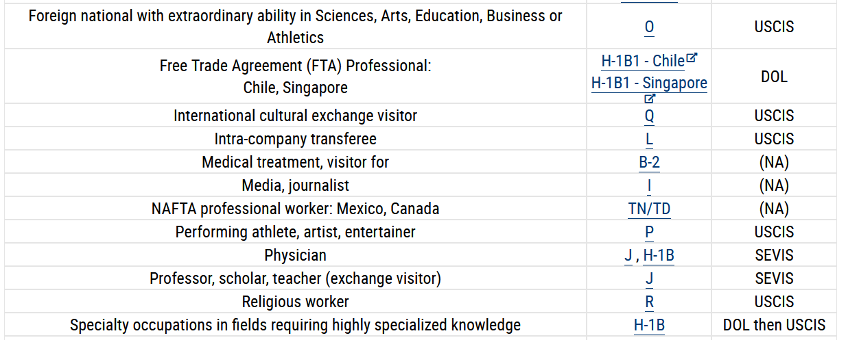
US Work Permits
Most will think of H-1B visas
Work on a lottery system
Limited amount of visas
Usually for the most talented and skilled people in fields that are “in demand”
https://travel.state.gov/content/travel/en/us-visas/visa-information-resources/all-visa-categories.html

Slide 11
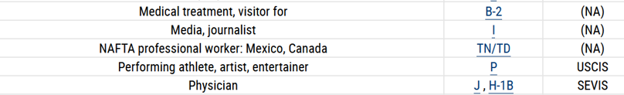
Which Work Permit Did I Get?
TN Status
Not a visa*
*Unless you are a citizen of Mexico
Usually requires a bachelors degree and/or 3 years’ work experience
No limit to how many applications are processed per year
Eligible for renewal every 3 years
Caveat: No path to citizenship
->

Slide 12
What’s Required for an Infosec Job?
Need 7 things at a minimum
Valid passport with empty page(s)
Bachelor’s degree (or 3 years’ experience)
School transcript
Offer letter
Support letter
$50 in debit or credit
Job category that aligns with the TN status list of approved professions
For a “detection engineer” the category is “computer systems analyst”
Not “engineer” as a “software engineer” or “computer programmer”
[OPTIONAL] credential evaluation if the degree is not in English or outside NA
Notes:
“mentioning that programming is part of the job duties may lead to the officer incorrectly classifying the position as a computer programmer job, which is not covered as a TN approved occupation.”

Slide 13
How Do You Get TN Status as a Canadian?
Apply when you catch a flight to the US or cross the land border
Preclearance airports or major land borders are best
There’s a list of airports and land crossings for “optimized processing”
https://www.cbp.gov/travel/canadian-and-mexican-citizens/traveling-tn-or-l1-visa-canada
Takes about 1-2 hours depending on your situation and the queue time
Tell the border officer you want to apply for TN status
You can go through the NEXUS line if you have it!
They will take you to a secondary screening area for the interview
Provide the 7 items
Done!

Slide 14

Story Time
Hopped on a plane to Calgary, stayed for one night
Before the return flight I went through preclearance
Moved to secondary screening
Got interviewed
Got the work permit
Flew home!

Slide 15
FAQ

Slide 16
What Are Some Obstacles to Job Hunting?
Need to ask in the initial phone screen if the company can help with the process
Not every company can accommodate you
Might be a job that requires security clearance
Company might not offer relocation assistance

Slide 17
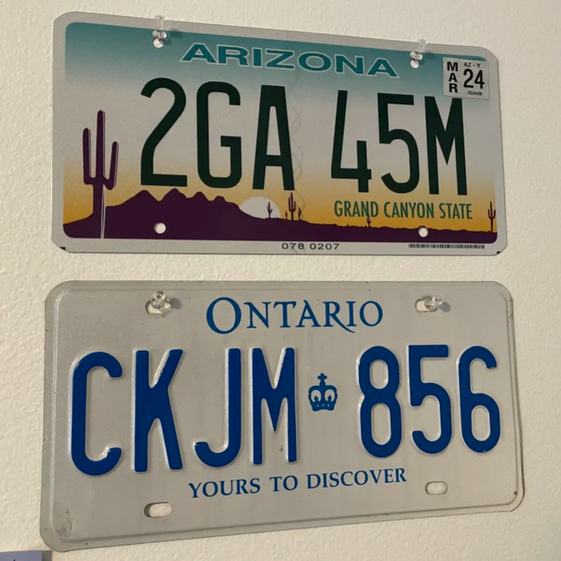
What Things Did you do After Getting the Job?
Confirmed I-94 was updated with TN status
Got a Social Security Number (SSN)
Filled out a bunch of paperwork with my company
Obtained a credit card
Got an AZ driver’s license
Got a bank account
Imported my car
Told people about it

Slide 18


How Hard Was it to Adjust?
Not very

Slide 19
Personal Living Experience
Cost of living is on average slightly higher
Even after conversion these things can be more expensive:
Food
Clothing
Rent
Car purchases
Wages and salary can offset these things

Slide 20
Social/Cultural Quirks?
They use imperial units instead of metric
Amazon.ca vs. amazon.com markup
Bagged milk is not a thing at all. Neither are milk pitchers
A double double is not a coffee with double cream and double sugar. It is a hamburger on the west coast
You go to use the "bathroom“ or “restroom”
An elastic band is a "rubber band"
People don’t usually say "sorry" when they bump into you, they say "excuse me"
Ketchup chips aren't a thing. or ketchup powder. you get funny or disgusted looks.
Taco bell has nacho fries (in certain locations) and fries supreme is not a thing
I get crap for emphasizing the 'L' in "salmon“

Slide 21
Summary
TN status is available for Canadians as an option to get a job in the US
There is no lottery system and an unlimited amount of applications
Applying is done at the port of entry
An employer may have/hire a lawyer to help you with the process, but this is not required. I went through the process by myself
You got this!

Slide 22

References
https://www.uscis.gov/working-in-the-united-states/temporary-workers/tn-nafta-professionals – TN Status Explanation
https://www.slideshare.net/slideshow/us-work-visa-infographic-59796963/59796963 - Common Work Visa Infographic
https://www.cbp.gov/travel/canadian-and-mexican-citizens/traveling-tn-or-l1-visa-canada - List of “optimized processing” locations for TN status applications
https://www.boundless.com/immigration-resources/tn-status-explained/ - Comparison of work permits
https://www.nafsa.org/regulatory-information/8cfr2146 - List of applicable professions covered

Slide 23
References Pt. 2
https://clairescc.com/blog/2022/11/12/TN-Obtained - My blog post that covers most material in this talk
https://legalservicesincorporated.com/immigration/do-i-need-an-evaluation-of-my-foreign-educational-credentials-for-tn-visas/ - Credential evaluation guide
https://legalservicesincorporated.com/immigration/can-i-get-a-tn-visa-for-it-professional-can-tn-visas-be-issued-for-software-engineers-can-an-it-person-get-a-tn-visa-can-a-hardware-engineer-get-a-tn-visa/ - Guidance about what category to use for detection engineers/software engineers
https://clairescc.com/blog - My personal blog

Slide 24

Thanks for listening. See you in DC902!
# cat photos: 11
Dedicated to Lina the Cat, 2018-2024

